Slide 1
BIG DATA LAB INTERNAL
Presented By
NAME – Upanshu Avi
USN – 1NT18IS177
ISE 6 ‘B’

Slide 2
Problem statement
Question-III
Prepare the dataset of 20 records in the following format,
Mongo DB
Demonstrate the usage of $match, $group, aggregate pipelines.
Demonstrate the Map-Reduce aggregate function on this dataset.
Count the number of Movies which belong to the thriller category and find out the total number of positive reviews in that category.
Group all the records by genre and find out the total number of positive feedbacks by genre.
Hadoop-Map Reduce
Use the Hadoop Map Reduce programming framework to compute with a program which will take the data from this .csv file and compute the following,
Count the number of referable movies from the dataset.
Find the Total number of positive feedbacks for the movie category “Suspense”
Movie Name | IMDB Rating | Genre(one) | Number of Positive Feedback | Referable
String | Float | String | Int | bool

Slide 3
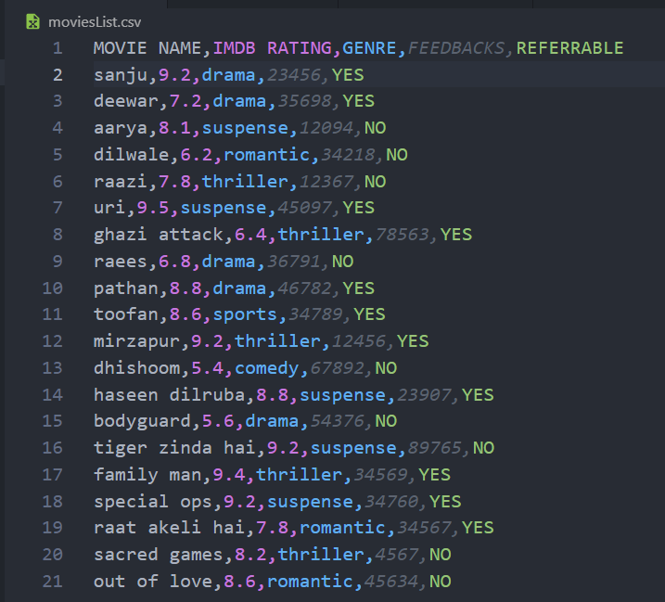
Dataset

Slide 4
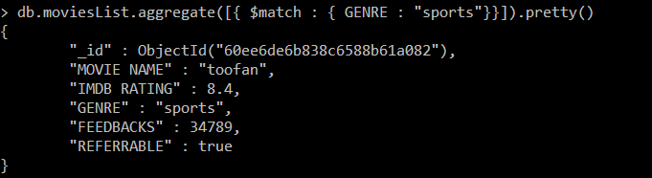
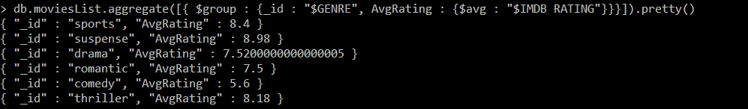
MONGO DB
1. Demonstrate the usage of $match, $group, aggregate pipelines.

Slide 5
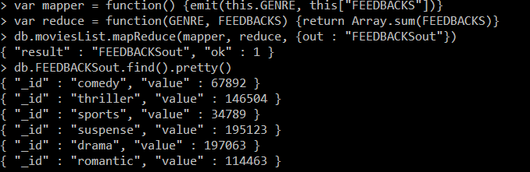
MONGO DB
2. Demonstrate the Map-Reduce aggregate function on this dataset.

Slide 6
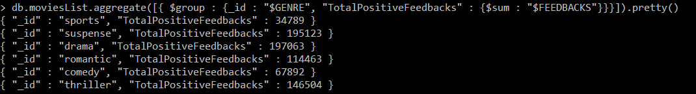
MONGO DB
3. Count the number of Movies which belong to the thriller category and find out the total number of positive reviews in that category.
4. Group all the records by genre and find out the total number of positive feedbacks by genre.

Slide 7
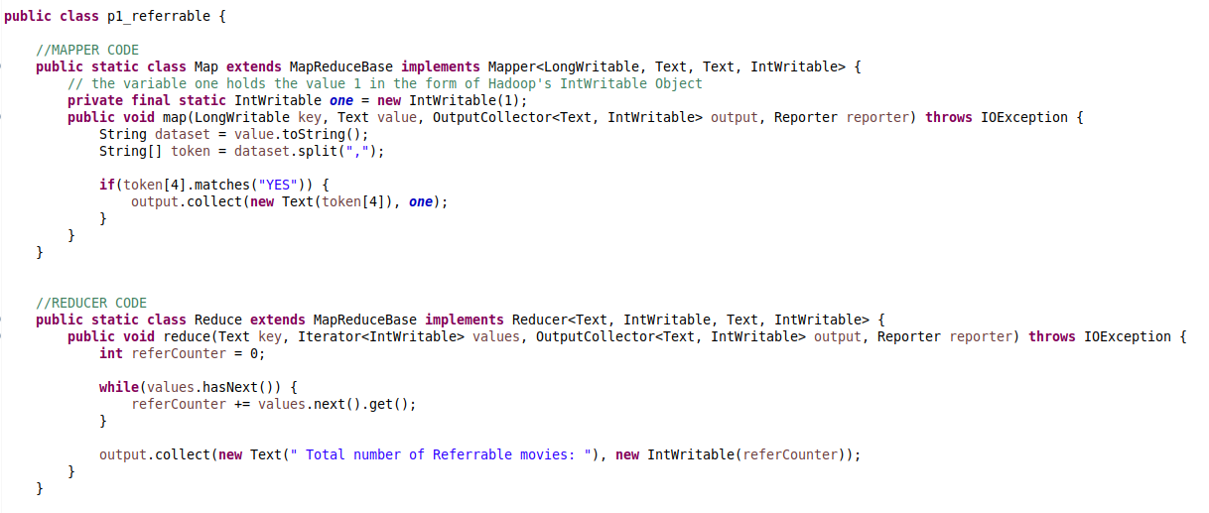
Hadoop MAP reduce
Count the number of referable movies from the dataset..

Slide 8
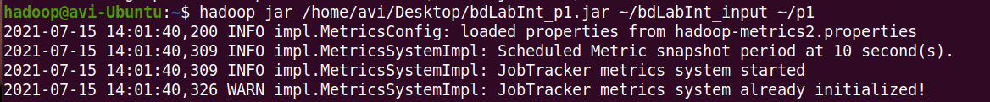
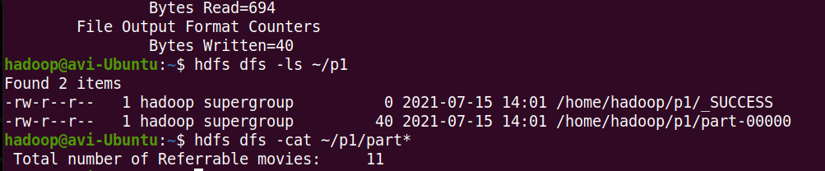
Hadoop MAP reduce
Output

Slide 9
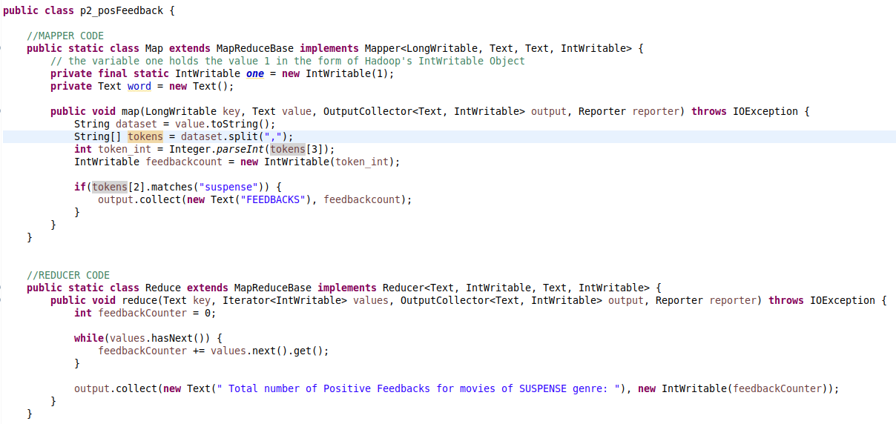
Hadoop MAP reduce
Find the Total number of positive feedbacks for the movie category “Suspense”.

Slide 10
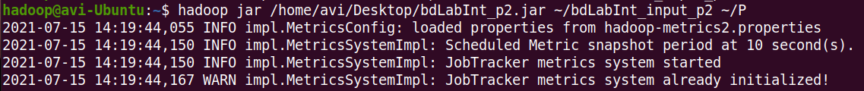
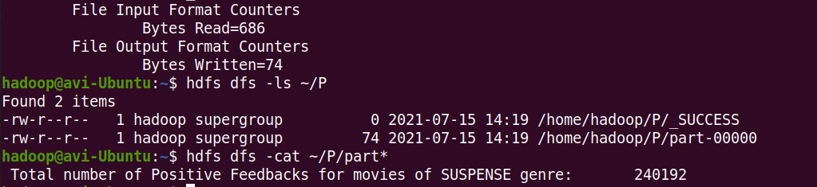
Hadoop MAP reduce
Output

